Slide 1
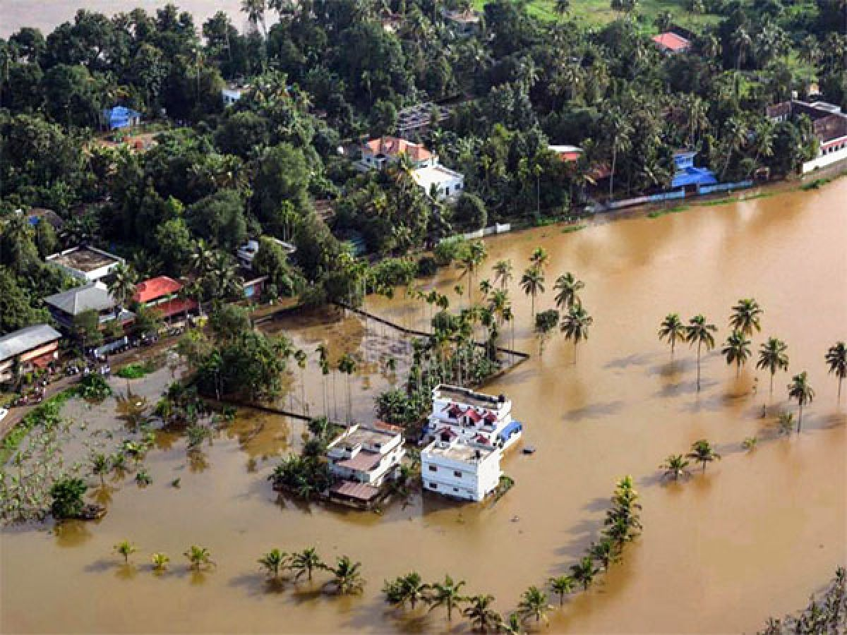
NATURAL DISASTER FORECASTING AND ALERTING DEVICE - FLOODS
TEAM ID: SB2477
TEAM MEMBERS:
Vishnu Priya S
Vishnu V
Mentor: Prof. Girija V
Dept. of CSE, CIT, Bengaluru

Slide 2
PROBLEM STATEMENT AND OBJECTIVE
Despite advancements in technology and disaster preparedness, the increasing frequency and intensity of floods due to climate change overwhelm current response capabilities. This leads to greater loss of life, property damage, and economic hardship, particularly in vulnerable communities.
Notes:
We aim to improve flood disaster management by enhancing preventative measures, communication infrastructure, and coordinated response efforts to build resilient communities that can effectively anticipate, prepare for, respond to, and recover from disasters

Slide 3
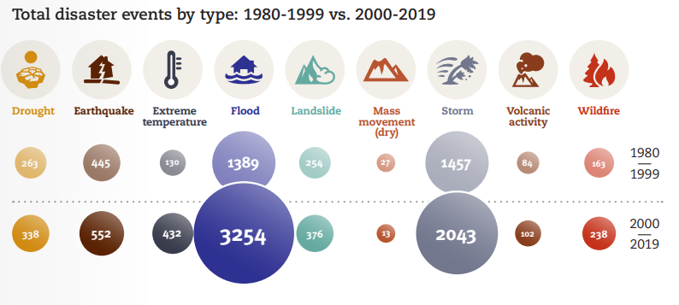
Disaster Risk Reduction in the 21st Century

Slide 4
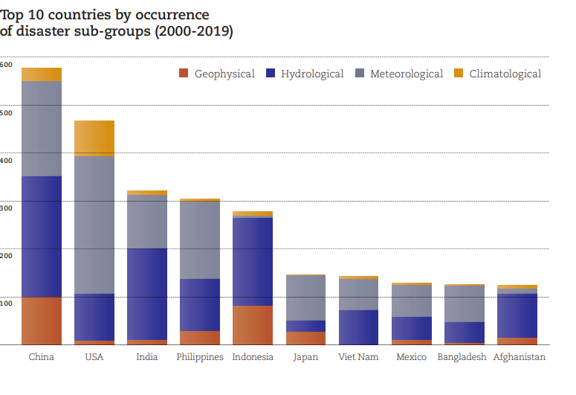

Slide 5
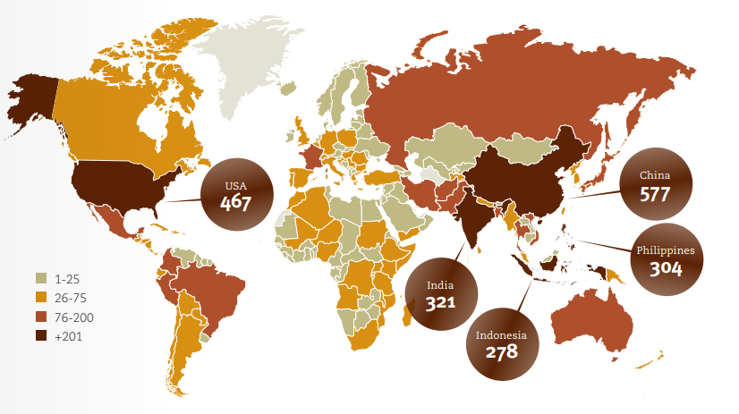

Slide 6
KEY STATS
Floods have the highest impacts in Asia, as the continent experienced 41% of all flooding events and with a total of 1.5 billion people affected.
Accounted for 93% of people affected by floods worldwide.
Africa (763 flood events)
Americas (680 flood events)
Research exploring the economic consequences of water risk fueled by climate change through 2050 predicts that droughts, floods and storms could wipe $5.6 trillion from the gross domestic product of key economies
Source Centre for Research on the Epidemiology of Disasters (CRED) United Nations Office for Disaster Risk Reduction

Slide 7
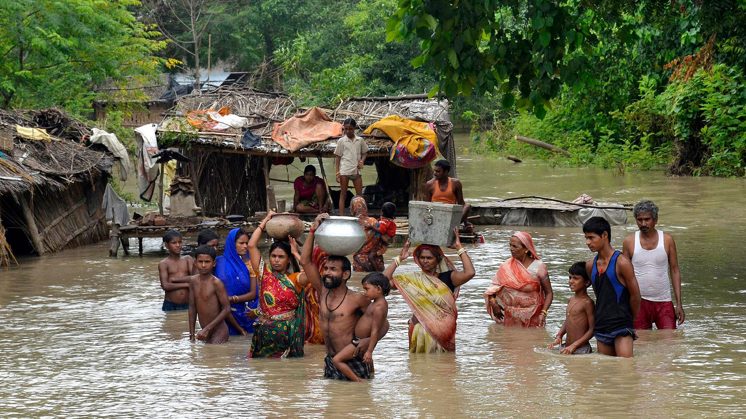
CUSTOMER PAIN POINT ADDRESSED
Psychological Trauma
Communication Breakdown
Property Damage
Economic Disruption

Slide 8
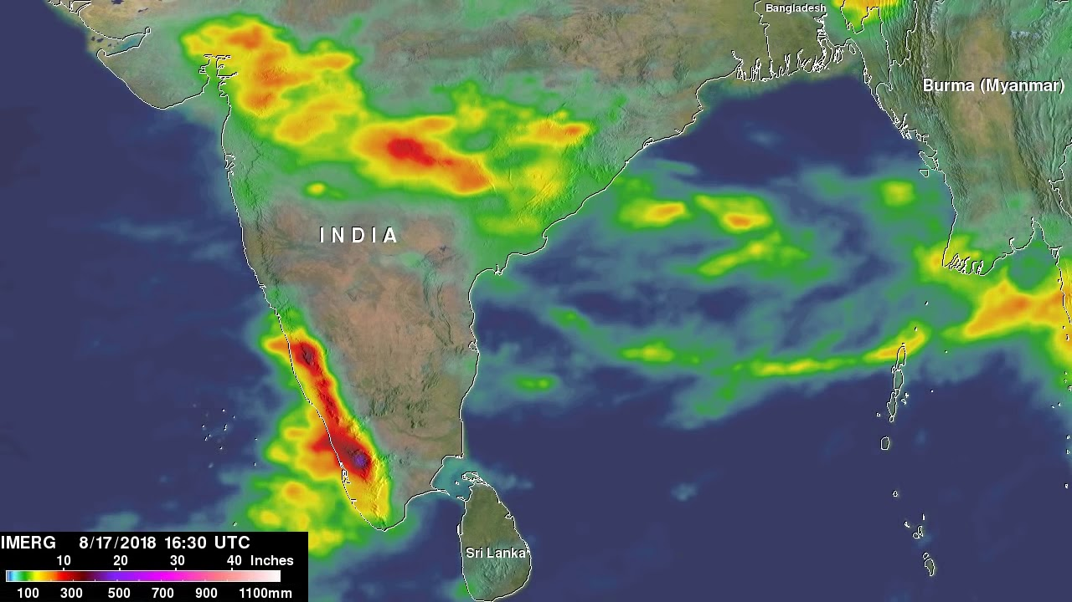
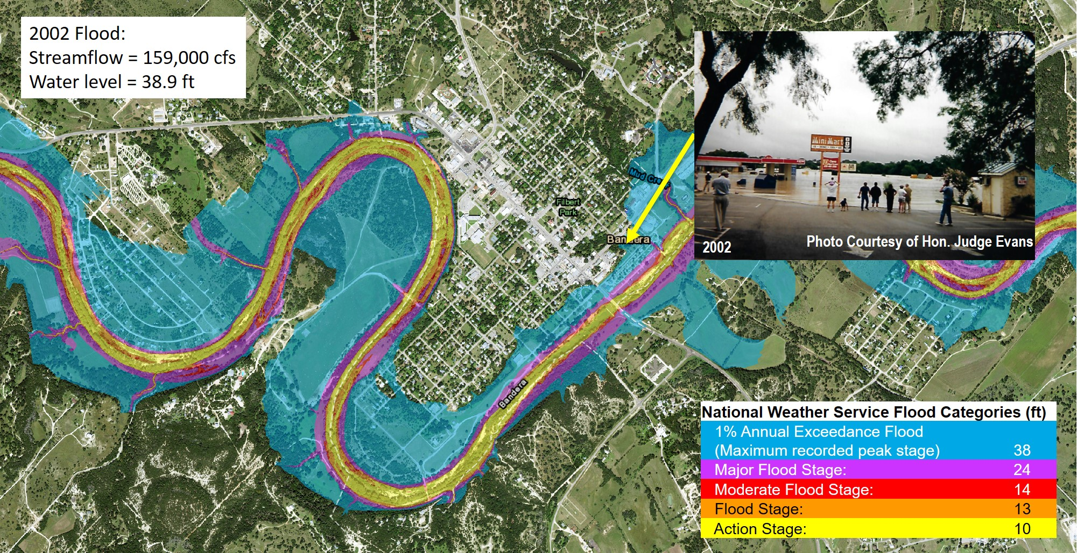
EXISTING METHODS FOR FORECASTING AND ALERTING
Satellite based analysis Flood Inundation Mapping

Slide 9
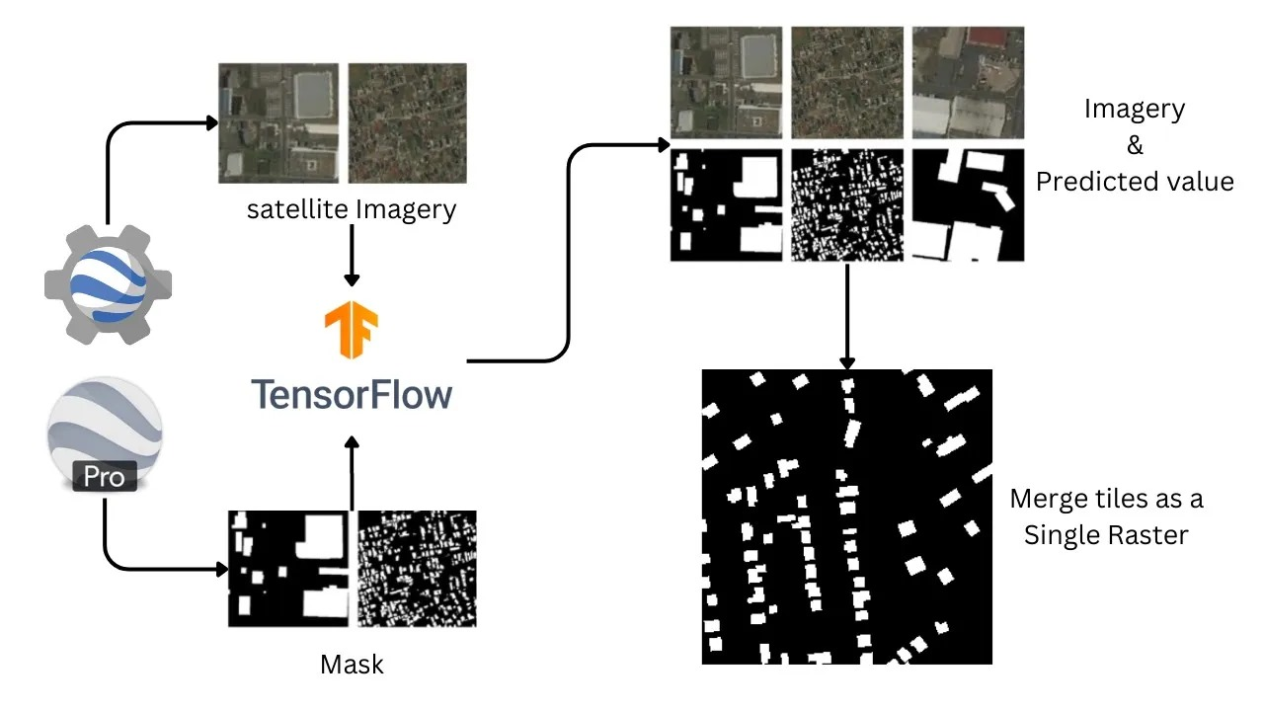
PROBLEM SOLUTION
AI Driven Forecasting System
Achieved

Slide 10
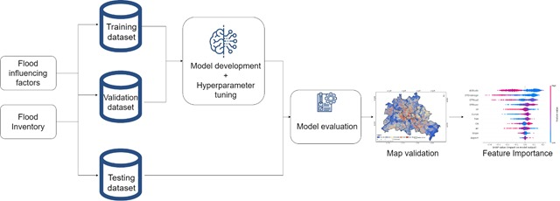
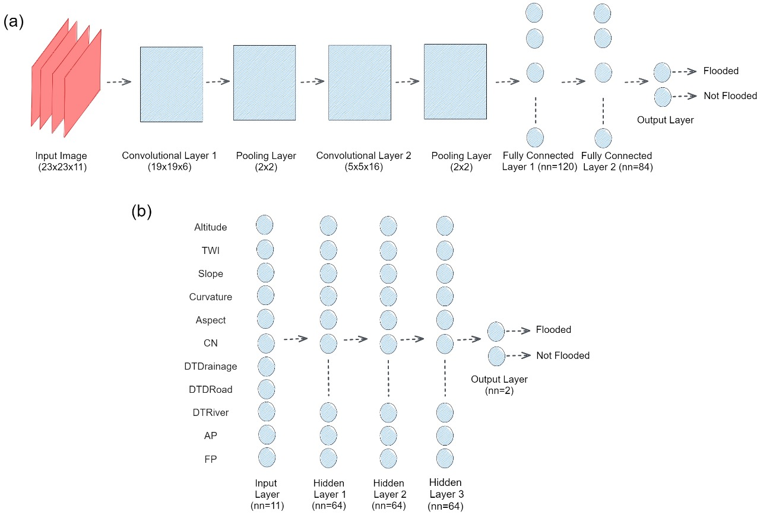
PROBLEM SOLUTION CONTD…
AI Driven Forecasting System - currently working on
Phase-1 figure-1 | Phase-1 figure-2

Slide 11
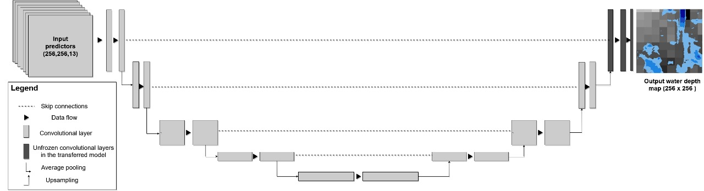
PROBLEM SOLUTION CONTD…
AI Driven Forecasting System
Phase-2

Slide 12
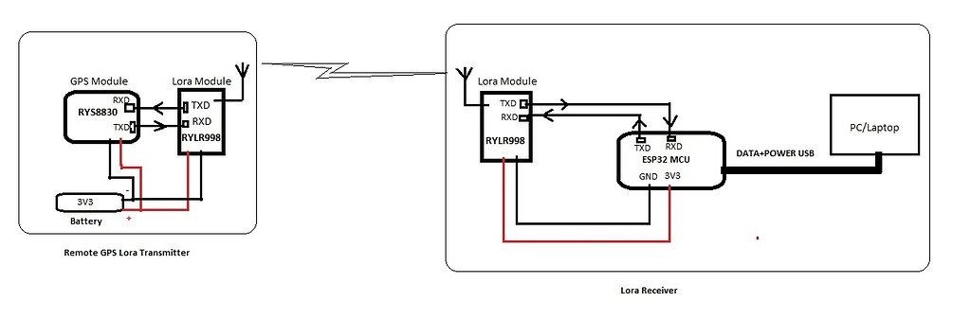
PROBLEM SOLUTION CONTD…
2. Rescue Aided Device [RAD]

Slide 13
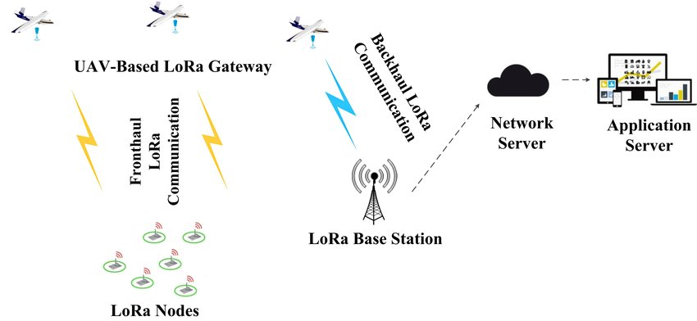

Slide 14
INNOVATIVENESS OF OUR PROJECT
Forecasting
RAD
CNNs excel at processing data with inherent spatial relationships and thus handle multi dimensional data.
CNN model recognizes the topographic depressions as areas with high flood susceptibility at the fine resolutions (5 and 2 m)
Early precautionary indication
Multi nodal synchronization and control of Autonomous swarm of drones
Continuous assistance throughout the disaster
Location Tracking

Slide 15
TECHNOLOGY USED
Forecasting
- U-NET Architecture
- Convolutional Neural Network
RAD [Rescue Aided Device]
- LoRa
- GPS [ Global Positioning System]

Slide 16
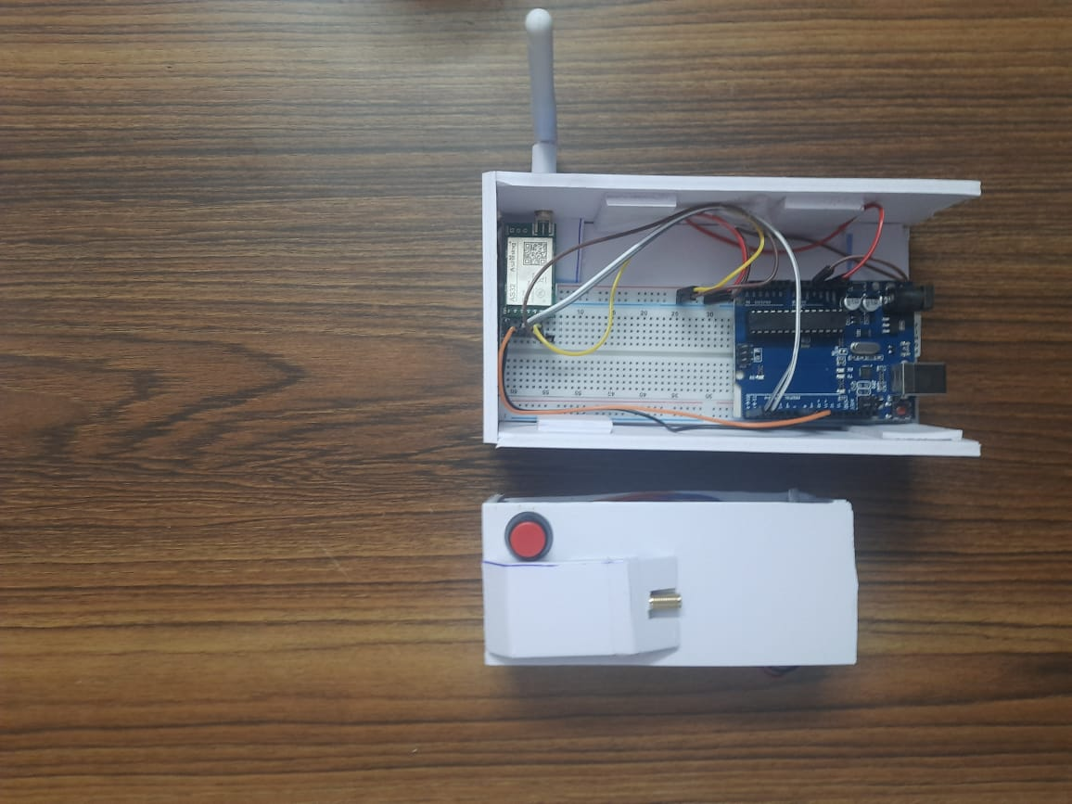
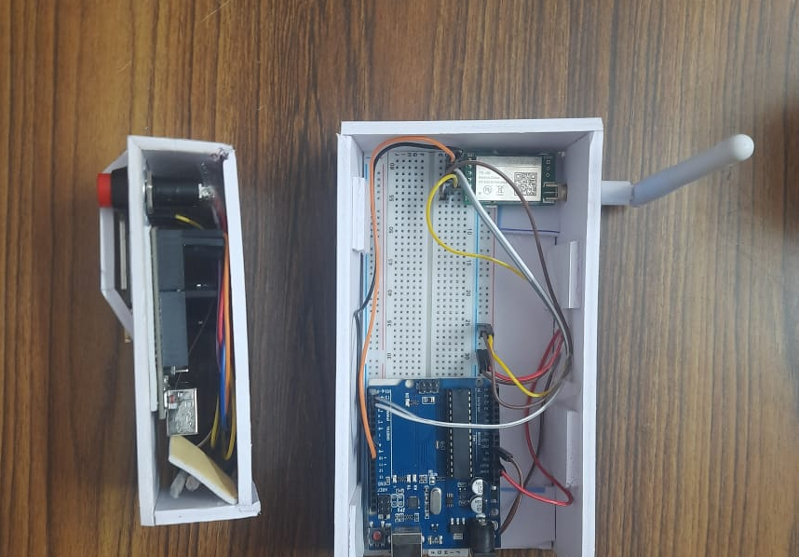
PROTOTYPE
TOP VIEW | SIDE VIEW

Slide 17
KEY FACTORS FOR FEASIBILITY
Geospatial data - need access to comprehensive historical and real-time data sets to train and run the network effectively.
Industrial collaboration.
Integrating seamlessly with existing forecasting and alerting systems is essential for real-world application.

Slide 18
Potential Revenue Streams
Data analysis and insights: Providing our data analysed to other forecasting companies to mitigate risks and reduce the pre and post flood effects.
Partnership with Government agencies and disaster management authorities - cost savings in disaster response and recovery efforts.
Private businesses can gain an edge by safeguarding their operations based on early warnings.

Slide 19
SCOPE FOR PATENTABILITY
There are patentable aspects to our project, particularly related to deep neural networks and RAD.
Our project can be applied for utility as well as design patents.
Multi nodal synchronization and control of Autonomous swarm of drones(Patent Filed, awaiting approval Received Funding of Rs. 2.5 Lakh INR, from Ministry of Science, Govt of India)
We Created an ensemble of AI powered algorithms that enable multiple drones to coordinate tasks simultaneously. To demonstrate swarm autonomy, we implemented CNNs and data from the inbuilt camera and radio data to create environmental awareness in the drones. The drones were successful in playing the Indian musical instrument “Jaltarang”.
As per the research, no IEEE paper has published on this, hence this product can be published as a paper as well as journals

Slide 20
FUTURE PLANS
Develop an efficient application for forecasting and alerting.
Implementation of autonomous swarm of drones
Develop a wearable device for kids - to monitor their activities and protect them from physical abuses, accidents.
Full time Coastal Region monitoring

Slide 21
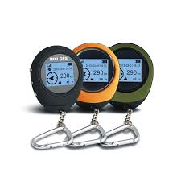
FUTURE PLANS

Slide 22


